Slide 1
A Nanotechnology-Inspired Grand Challenge for Future Computing
R. Stanley Williams
Senior Fellow
Hewlett Packard Labs

Slide 2
Outline
Sensible Machine Response to OSTP RFI
Foundations of Nonlinear Dynamics and Circuit Theory
Structure of a Multidisciplinary Neuromorphic Computing Program
The Chinese Brain-Inspired Computing Research Program at Tsinghua U.
After Moore’s transistor shrinking is over, what’s next?
Nonlinear dynamical systems
Nonvolatile (synaptic) and locally active (neuronic) memristors
Understanding, models and simulation
Predict the behavior of a nonlinear dynamical system
Calibrate and validate models
Electrical test, and physical and chemical characterization
Microphysical understanding
High resolution in energy, space and time
Challenge - watching nanoscale devices operate on nanosecond time scales

Slide 3
The “Sensible Machine” response to OSTP RFI
“The central thesis of this white paper is that although our present understanding of brains is limited, we know enough now to design and build circuits that can accelerate certain computational tasks; and as we learn more about how brains communicate and process information, we will be able to harness that understanding to create a new exponential growth path for computing technology.”
Our challenge as a community is now to continuously perform more computation per unit energy rather than manufacture more transistors per unit area.

Slide 4

Confirmed Keynote Speakers:
Kwabena Boahen, Stanford University
Leon Chua, UC Berkeley
David DiVincenzo, RWTH Aachen University
Neil Gershenfeld, MIT
Hideo Mabuchi, Stanford University
Luping Shi, Tsinghua University
and more...

Slide 5
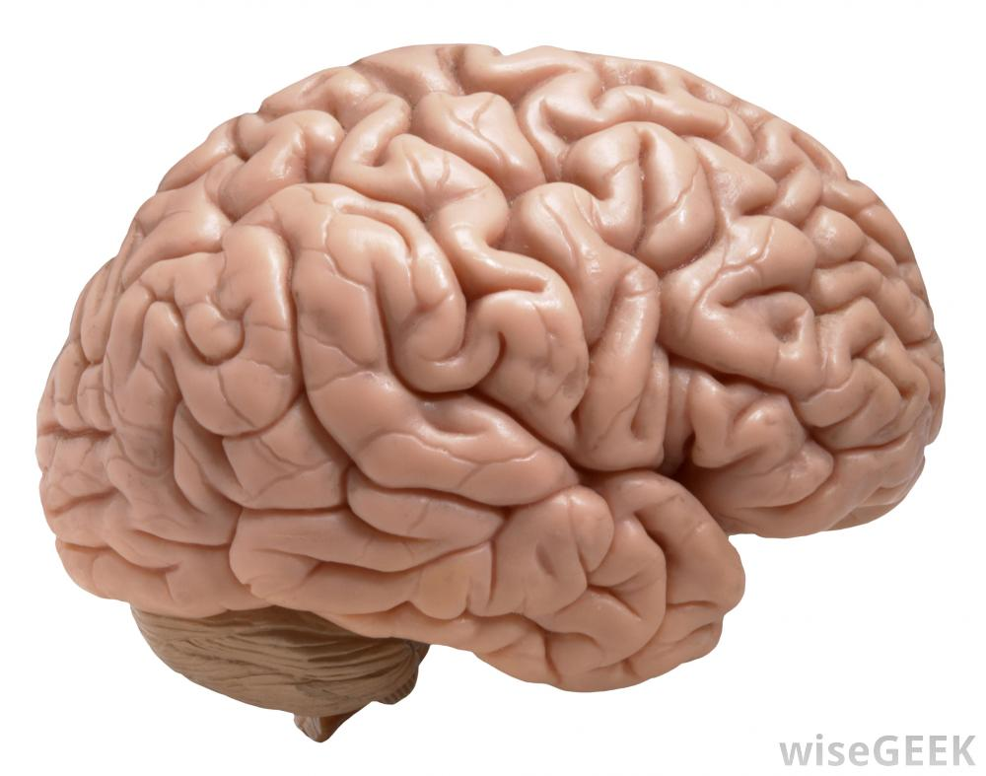
An apparent contradiction: A model in power efficiency!
<25 Watts @ 100 Hz
What are the state variables for communication and computation?
Ion currents and molecular concentration gradients: very slow, moderate energy
How is information processed by an extremely nonlinear dynamical system?
Notes:
Apr 2007 Blue Gene /L with 4e3 processors ran a simulation of half a mouse brain (8 million neurons, up to 6300 synapses [no total synapse # provided]) for 10 seconds (only 1 s in the mouse brain).

Slide 6
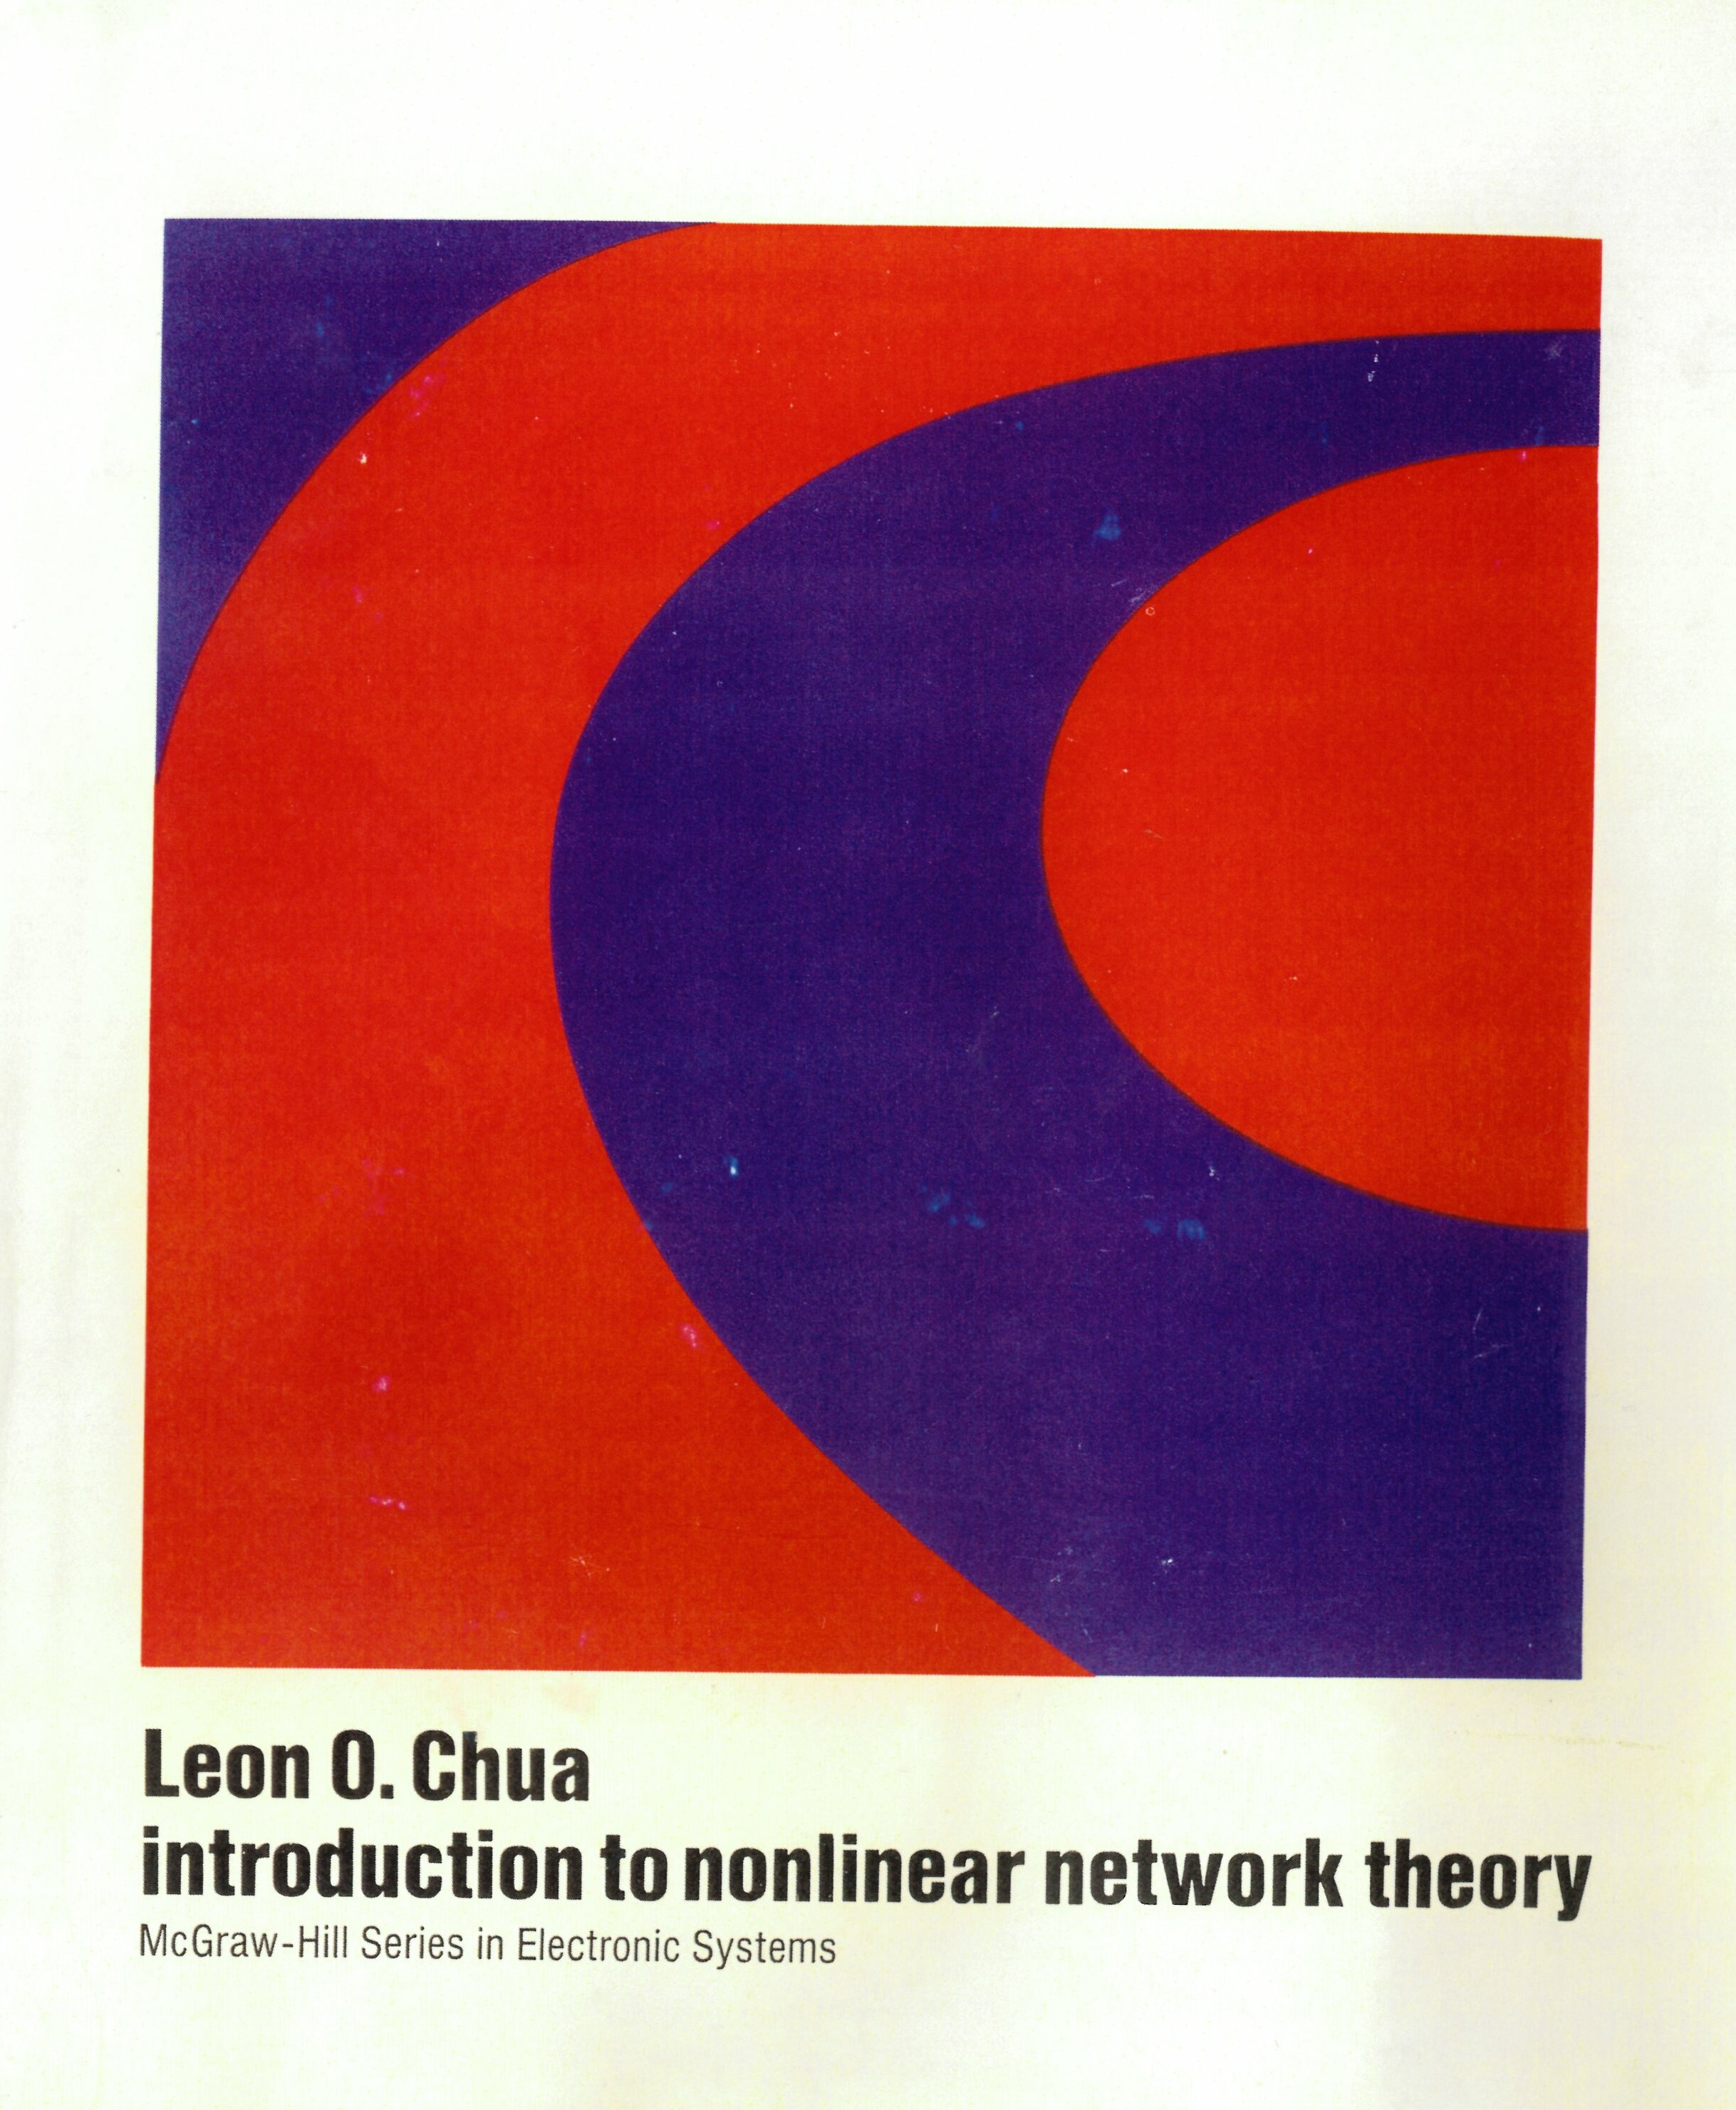
Leon Chua: the Father of Nonlinear Network Theory
Book published in 1969
Nearly 10 years to develop theory
Axiomatic approach to nonlinear circuits
Measure with voltmeter and ammeter Defined flux and charge as time integrals
Derived everything else for the general case
No particles or fields, independent of physics
Contains physics concepts as a subset
Largely ignored for 47 years
Community avoided nonlinearity

Slide 7
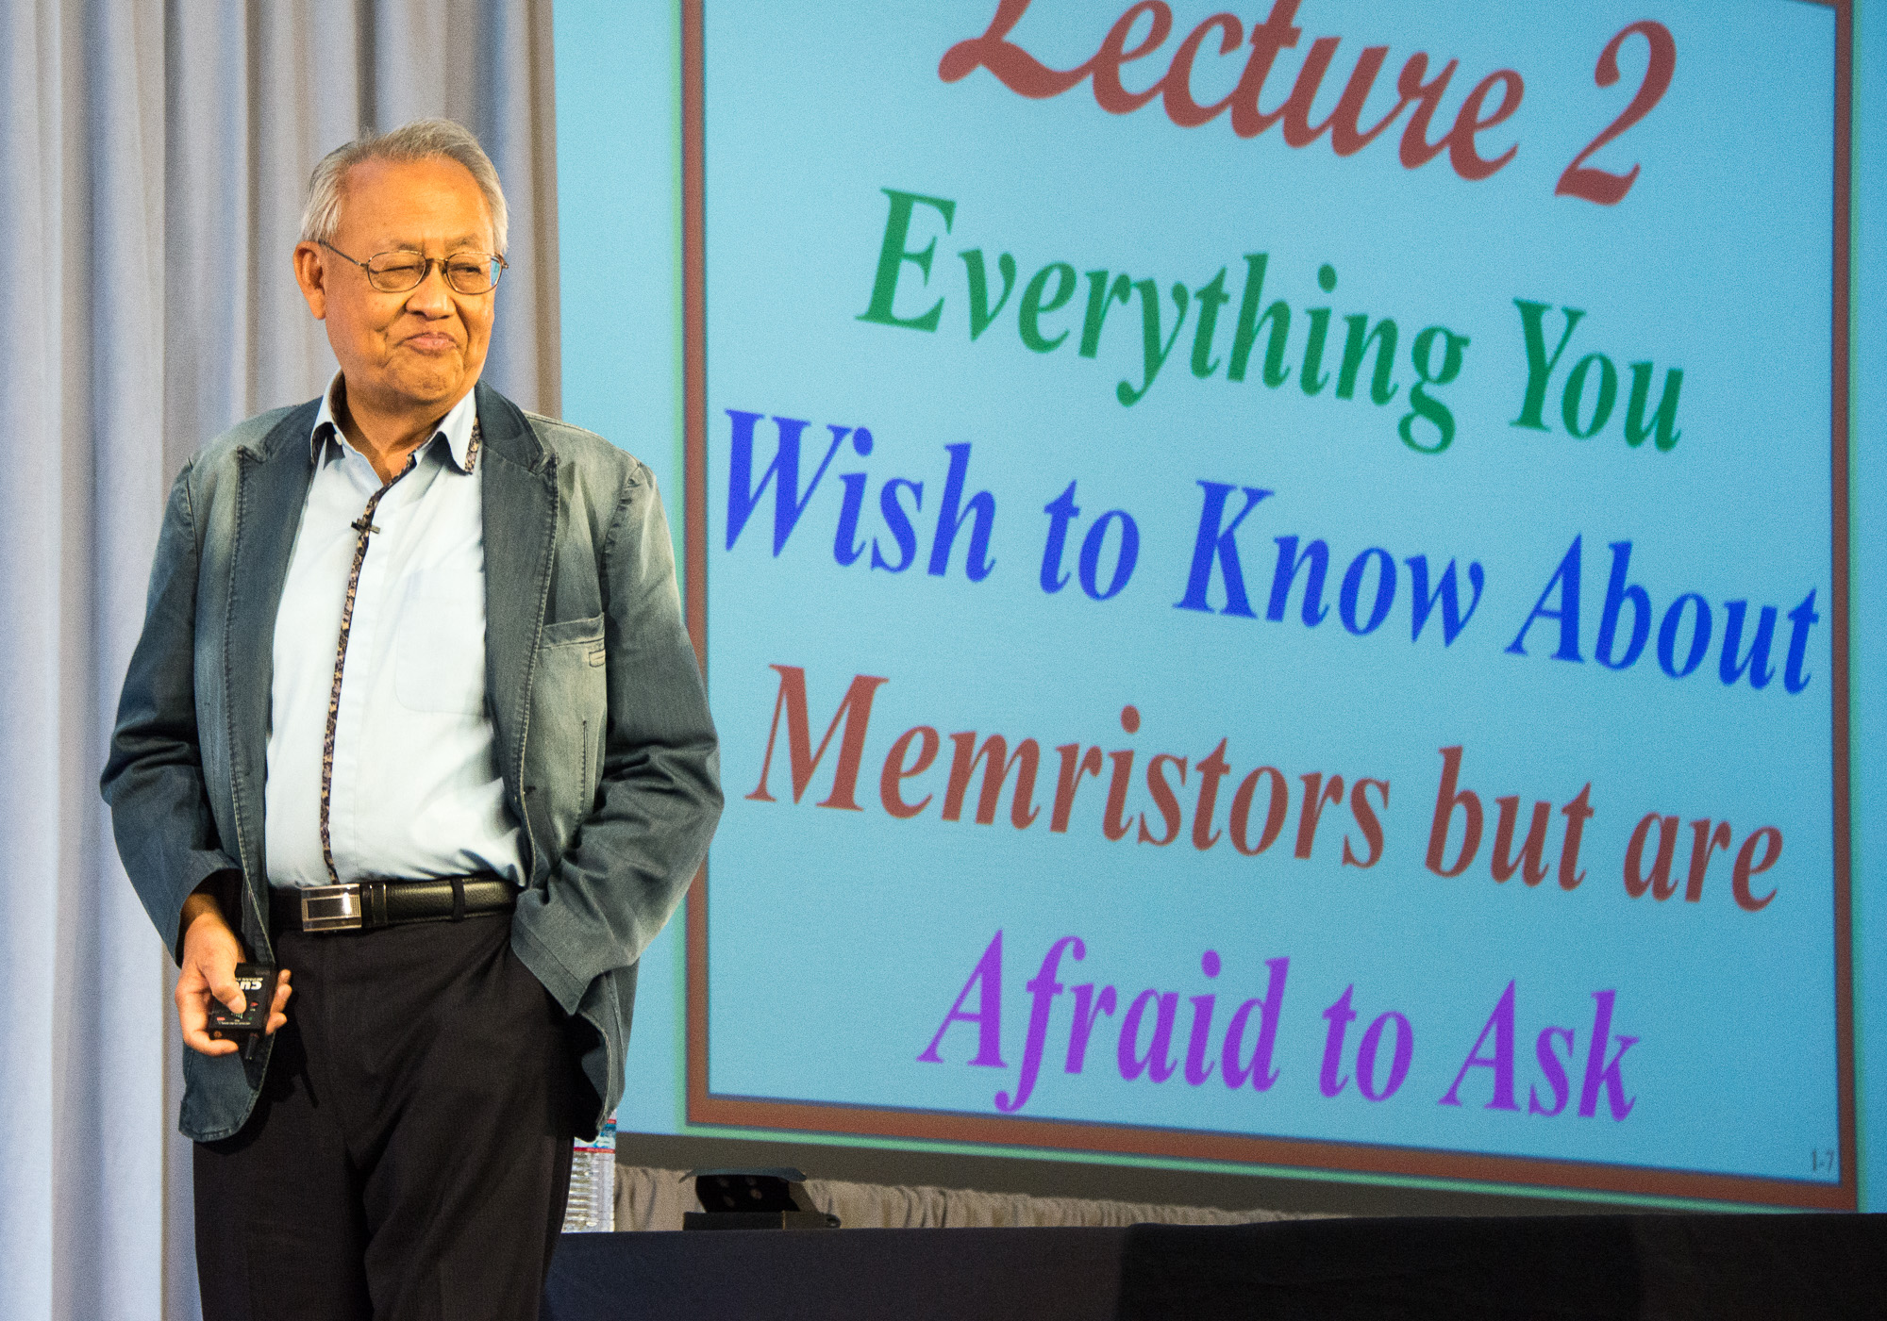
The Chua Lectures: A 12-Part Series with HPE Labs
From Memristors and Cellular Nonlinear Networks to the Edge of Chaos
https://www.youtube.com/playlist?list=PLtS6YX0YOX4eAQ6IrOZSta3xjRXzpcXyi
or enter “The Chua Lectures” into your favorite browser
‘Linearize then analyze’ is not valid for understanding nanodevices or neurons – a nonlinear dynamical theory of electronic circuits is needed, and was developed 35 years ago!
Chua has done for Kirchoff’s Laws what Hamilton and Einstein did for Newton’s Laws

Slide 8
Structure of a Neuromorphic Computing Program
Example: Chinese Brain-Inspired Computing Research
Tsinghua University:
Operating for over three years
35 faculty from seven departments in eight groups
Well conceived, led and funded (internally by Tsinghua)
Already fabbed two chips with a third taped out
Planning to expand program internationally

Slide 9
Song, S., Miller, K., Abbott, L.F.* (2000)
Competitive Hebbian learning through
spike-timing-dependent synaptic plasticity.
Nature Neuroscience,3:919-926.
(cited 1469 times)
Review of CIBCR, Tsinghua U.

Slide 10
Structure of a US Neuromorphic Computing Program
1. Connect Theory of Computation with Neuroscience and Nonlinear Dynamics
e.g. Boolean, CNN, Baysian Inference, Energy-Based Models, Markov Chains
2. Architecture of the Brain and Relation to Computing and Learning
Theories of Mind: Albus, Eliasmith, Grossberg, Mead, many others
3. Simulation of Computational Models and Systems
4. System Software, Algorithms & Apps – Make it Programmable/Adaptable
5. Chip Design – System-on-Chip: Accelerators, Learning and Controllers
Compatible with standard processors, memory and data bus
6. Chip Processing and Integration – Full Service Back End of Line on CMOS
DoE Nanoscale Science Research Centers (NSRCs) – e.g. CINT
7. Devices and Materials – in situ and in operando test and measurement
Most likely materials will be adopted from Non-Volatile Memory

Slide 11

A New Platform Architecture
Today
The Machine
Constant struggle between cost and performance
Enabling petabyte data sets
Faster
More cost per bit
On-chip cache
SRAM
Massive Memory Pool
High density nonvolatile memory
Main memory
Faster
DRAM
Capacity
Mass storage
Flash
Hard disk
Capacity
cheaper, much higher density,
much lower power consumption
than DRAM
Notes:
90% of a computer’s work is shuffling data between tiers.
Today, scientists, mathematicians and economists have had to spend their careers working out how to perform their calculations instead of their actual work – translating simple equations into complex parallel processing tasks because the core/memory ratio is off
This picture is a simple version of the hierarchy. In some cases, it can be 9 or even 11 layers deep. In geek land, we call this “the volatility chain”.
We’re going to throw out the memory hierarchy – universal memory collapses the time to solution
Stop wasting time and energy shuffling; enable massive data sets impossible today.
We’ll use a blend of technologies to enable a rapid shift to Universal memory.
This lets us program for and realize the benefits of Universal Memory, bolting in different underlying technologies as they mature
We believe Memristor is the best long-term candidate. More on that later in the “making The Machine Real” section.

Slide 12
Breaking the von Neumann bottleneck
Memory
Can be an FPGA,
GPU or ASIC!
Memory
Memory
SoC
SoC
SoC
SoC
Memory
Memory
SoC
SoC
SoC
SoC
SoC
SoC
Memory + Fabric
Memory
SoC
SoC
Memory
SoC
SoC
SoC
SoC
Memory
Memory
SoC
SoC
SoC
SoC
SoC
SoC
SoC
Memory
Memory
…to Memory-Driven Computing
From Processor-Centric…
SoC
Memory
Notes:
Here’s another way of looking at the shift:
Traditional computers chop up your information – the data – to match the limitations of the processor
Processor as gatekeeper
We flip flips that around and puts the data first – bringing processing to the data
Processor almost irrelevant – can swap out to suit task
We call this Memory-Driven Computing
SoC, universal memory and photonics are the key parts of the architecture of the future
With this architecture, we can ingest, store and manipulate truly massive datasets while simultaneously achieving multiple orders of magnitude less energy/bit
Q: What is HP doing here that is truly different?
A: New technologies are not substitutional - we’re re-architecting

Slide 13
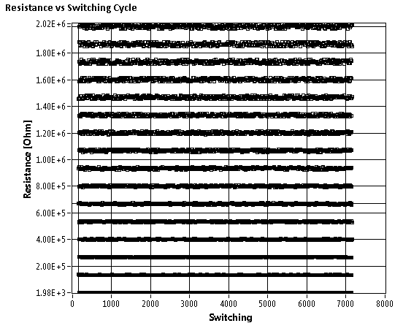
Accelerates many operations: FT, Metropolis-Hastings, Simulated Annealing. 3-4 orders of magnitude speed-up for certain (restricted but important) applications
Dot Product Engine – brain inspired computing in analog memory
Memristor array = matrix G_{ij}
Requires non-binary states for each memristor
Computes Matrix-vector dot product V^{I} * G in one time step via Kirchoff’s Laws

Slide 14
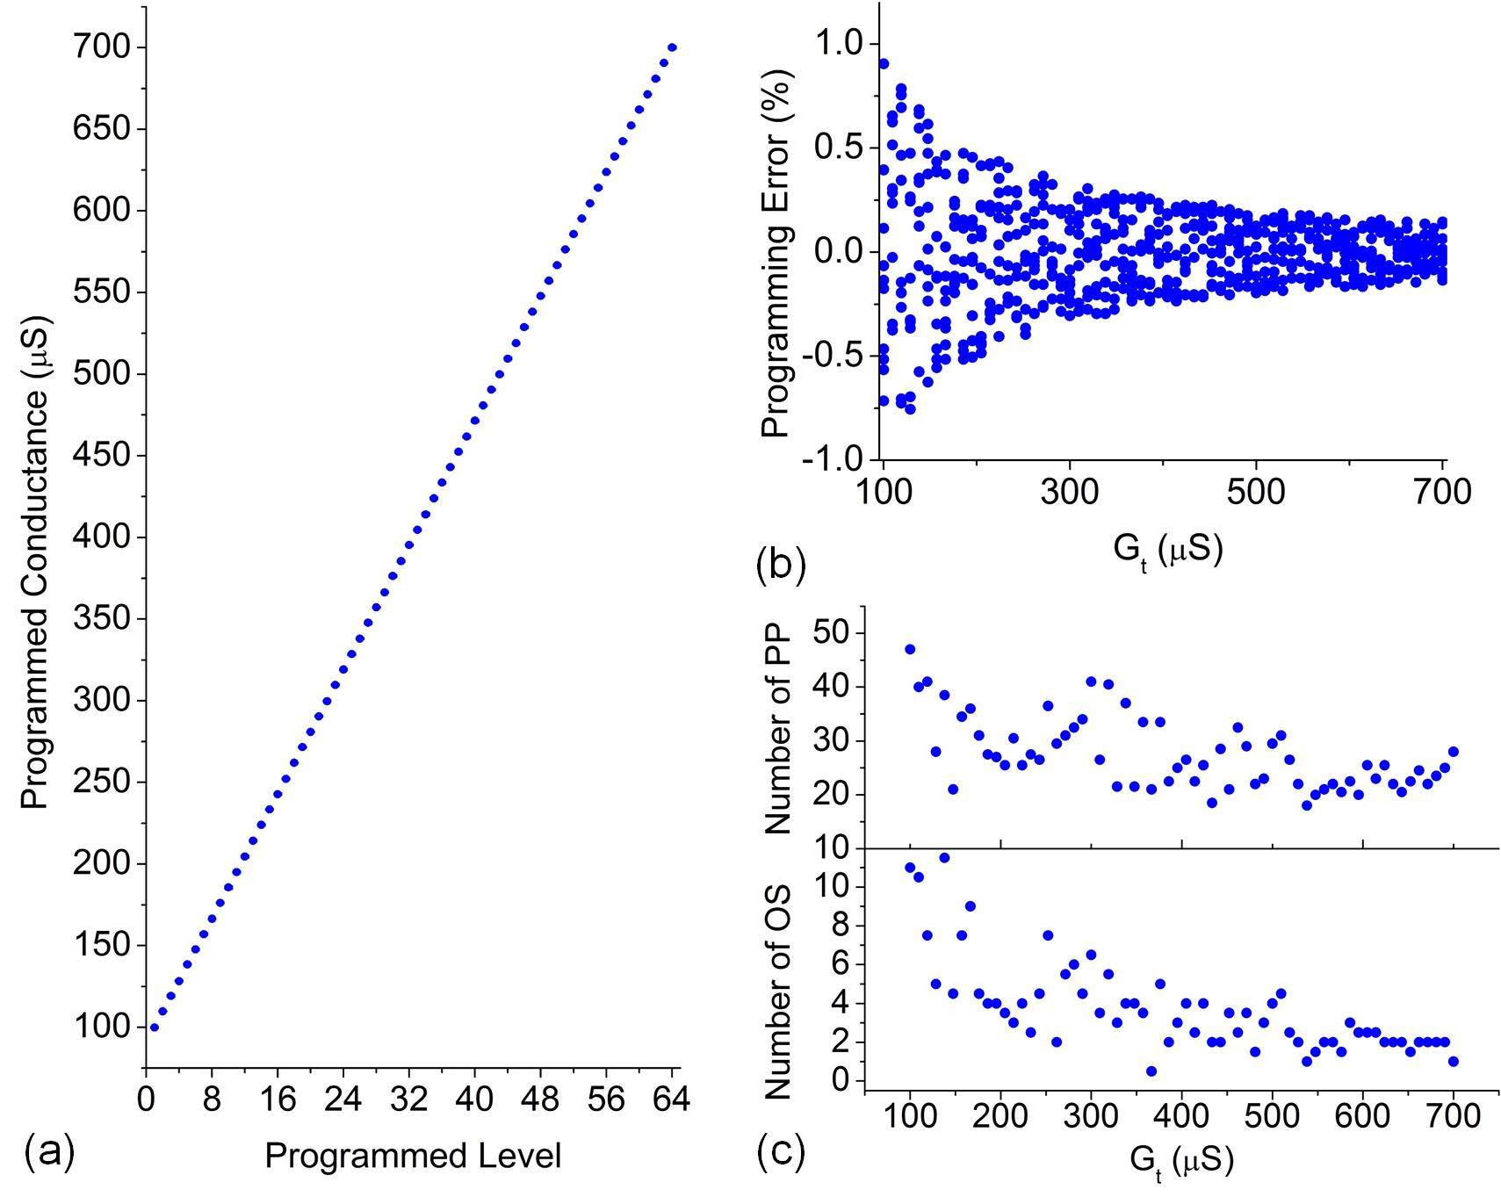
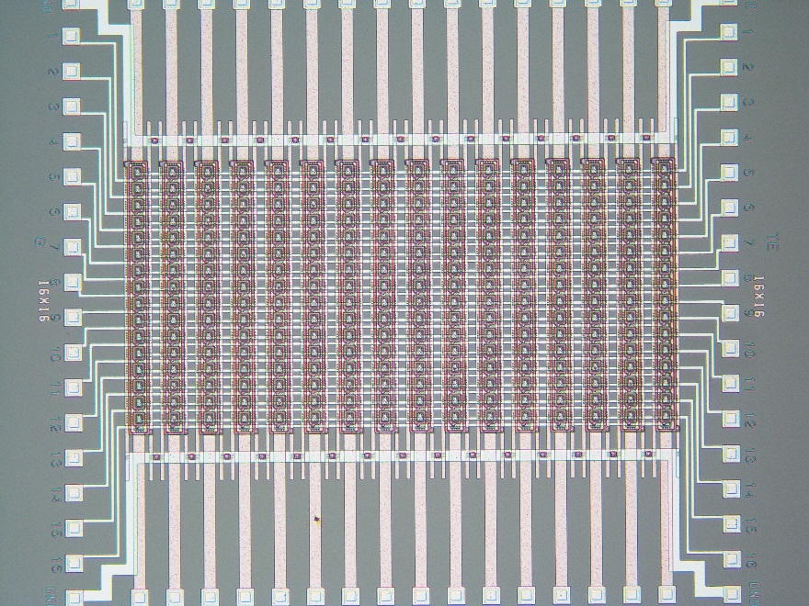
Integration of Memristors + NMOS (1T1R crosssbar
16 × 16 array
>6 bit resolution
6-bit resolution
Yield: 256/256

Slide 15
An actual memristor crossbar is non-ideal
Resistance of devices in an array can be
adjusted to compensate for nonlinear
memristors and finite resistance of wires
High precision tuning of state for memristive devices
by adaptable variation-tolerant algorithm, Fabien Alibart,
Ligang Gao, Brian D Hoskins and Dmitri B Strukov,
Nanotechnology 23 (2012) 075201.
Miao Hu, et al., several publications to appear 2016.

Slide 16
Potentially significant increase in speed and efficiency
Results of realistic simulations for known and imperfect memristor properties
Miao Hu, et al., several publications to appear 2016.

Slide 17
The memristor is now in vogue as a neuromorphic device
Quasi-static conduction eq. – Ohm’s Law
Dynamical eq. – evolution of state under stimulus
L. O. Chua, “Memristor - the missing circuit element,” IEEE Trans. Circuit Theory 18, 507–519 (1971).
L. O. Chua and S. M. Kang, "Memristive devices and systems," Proc. IEEE, 64 (2), 209-23 (1976). –
w is the state variable (or variables)
It describes physical properties of the circuit element that
determine its resistance (or conductance).

Slide 18
Two general types of memristors:
Nonvolatile:
‘Synaptic’
State stored as resistance
Continuously variable
Many Examples
ReRAM – vacancies in oxides
PC RAM – Ge-Sb-Te
STT RAM – spins (binary)
Locally Active:
‘Neuronic’ and/or ‘Axonic’
State transmitted as spike
Looks digital
Threshold switching, NDR
Gain, oscillations, chaos
Mott transitions - oxides
Amorphous Ge-Sb-Te

Slide 19
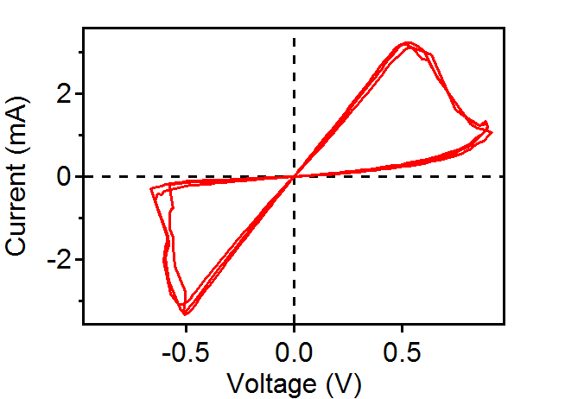
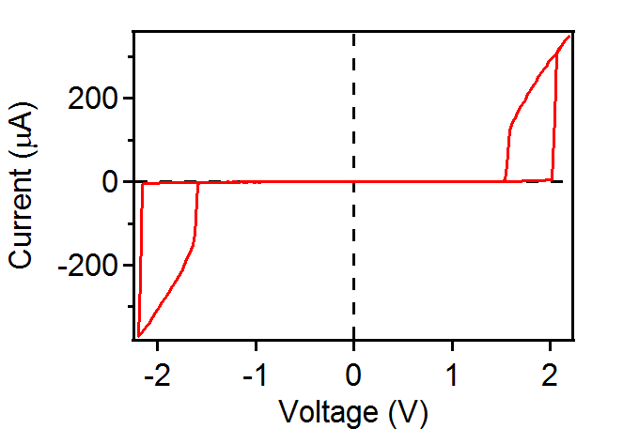
Memristors have ‘pinched’ hysteresis loops
Leon Chua, IEEE Trans. Circuit Theory 18, 507 (1971).
Nonvolatile Memristor
- Emerging digital memory/storage
- Synapse in neuromorphic circuit
Locally Active (e.g. “Mott”) memristor
- Emerging neuronal compute device
- Passive “selector” in crossbar memories

Slide 20
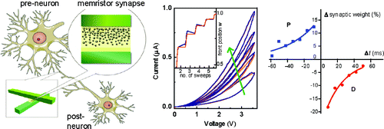
Viable path toward scalable brain-like computing?
Neuron (neuristor)
Locally active memristors
Captures key features of the brain:
1) Non-linear dynamics (“edge of chaos”) of neurons
2) High density architecture, localized memory
i.e. not the von Neuman architecture with physically separated compute and memory !
3) Massive parallelism
Synapse
Nonvolatile memristors
Sung Hyun Jo, et al. Nano Lett. 10, 1297 (2010)
With thanks to Erik DeBenedictis

Slide 21
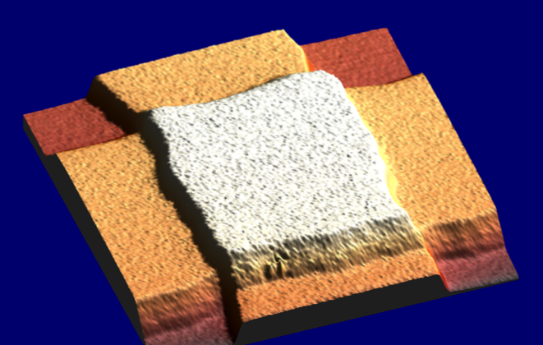
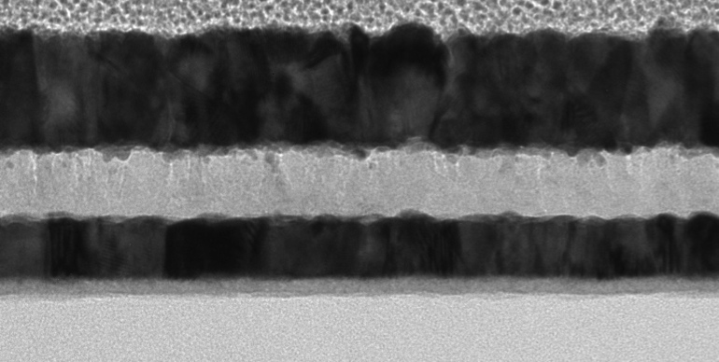
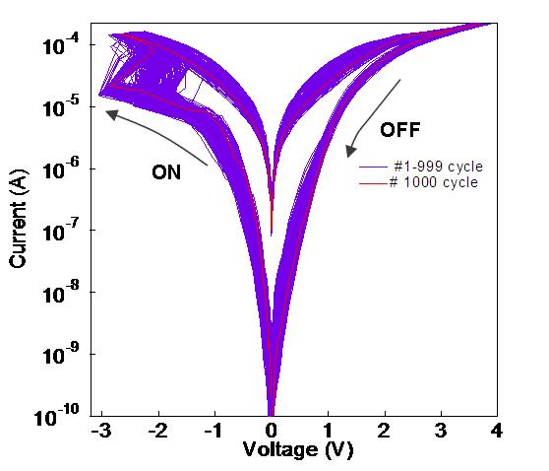
Understanding Memristor Microphysics
+
Pt
10nm – 10μm
V
-
oxide
Pt
20 nm
An accurate, predictive circuit model needs a good microphysical model
Key questions:
What are the important physical processes involved in switching (heating, drift, diffusion)?
Role of oxygen vacancies (n-type dopants), electromigration, dielectric breakdown, migration of the metal electrode atoms? Metal/oxide schottky-barrier physics, electrochemistry, etc.
Approach: materials/device characterization + electrical modeling

Slide 22
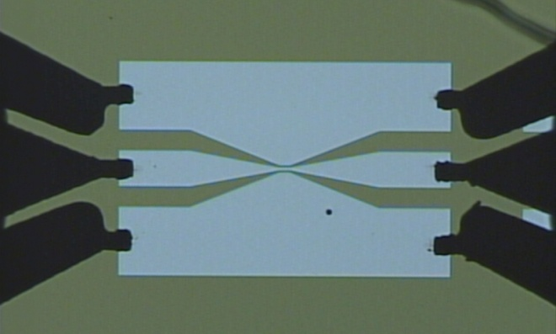
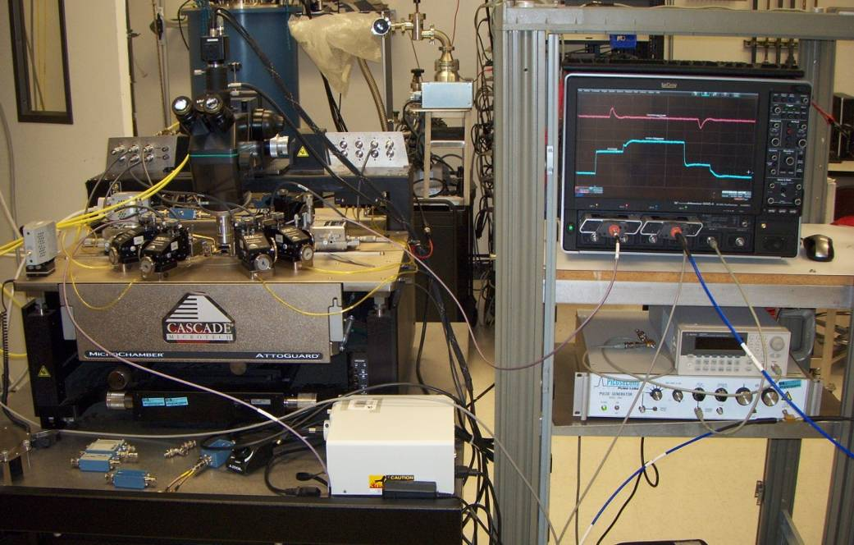
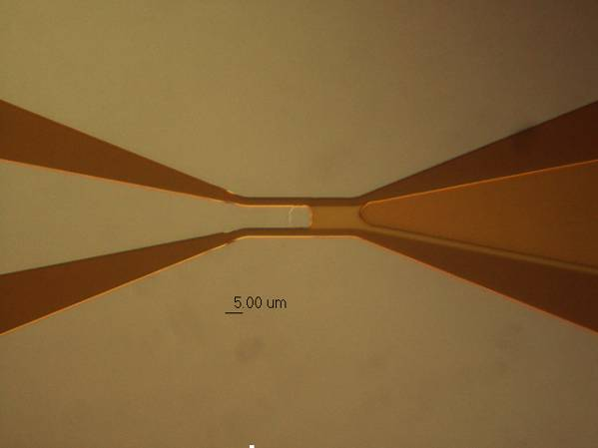
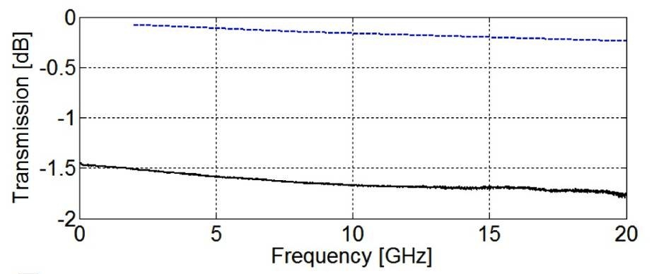
Need for high speed dynamic electrical testing
Real-time Oscilloscope
Coplanar Waveguide
200 μm
Memristor
Top Electrode
Bottom Electrode
Fast pulse generator
> 30 GHz bandwidth
A. C. Torrezan, et al., Nanotechnology, 22, 485203 (2011)
J. P. Strachan, et al., Nanotechnology, 22, 505402 (2011)

Slide 23
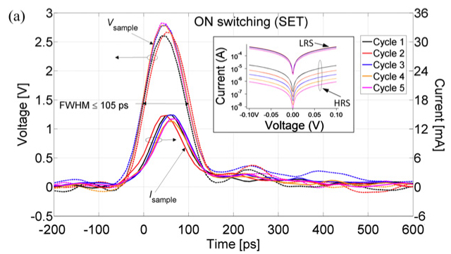
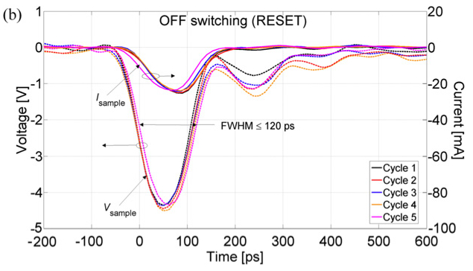
~100 ps ON and OFF switching in TaO_{x}

Slide 24
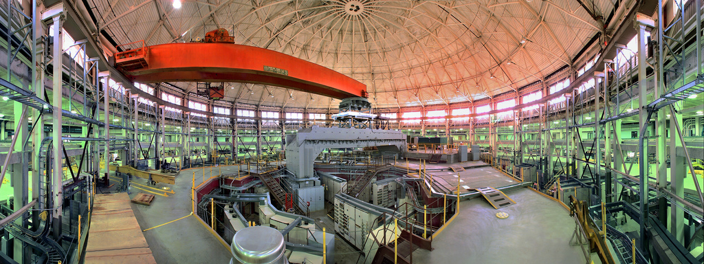
Getting nanoscale chemical resolution: STXM at the ALS
Scanning Transmission X-ray Microscope (STXM)
in situ and in operando
Spatial resolution down to 25nm
Probes entire depth of sample
Energy resolution (70 meV) for chemical identification

Slide 25
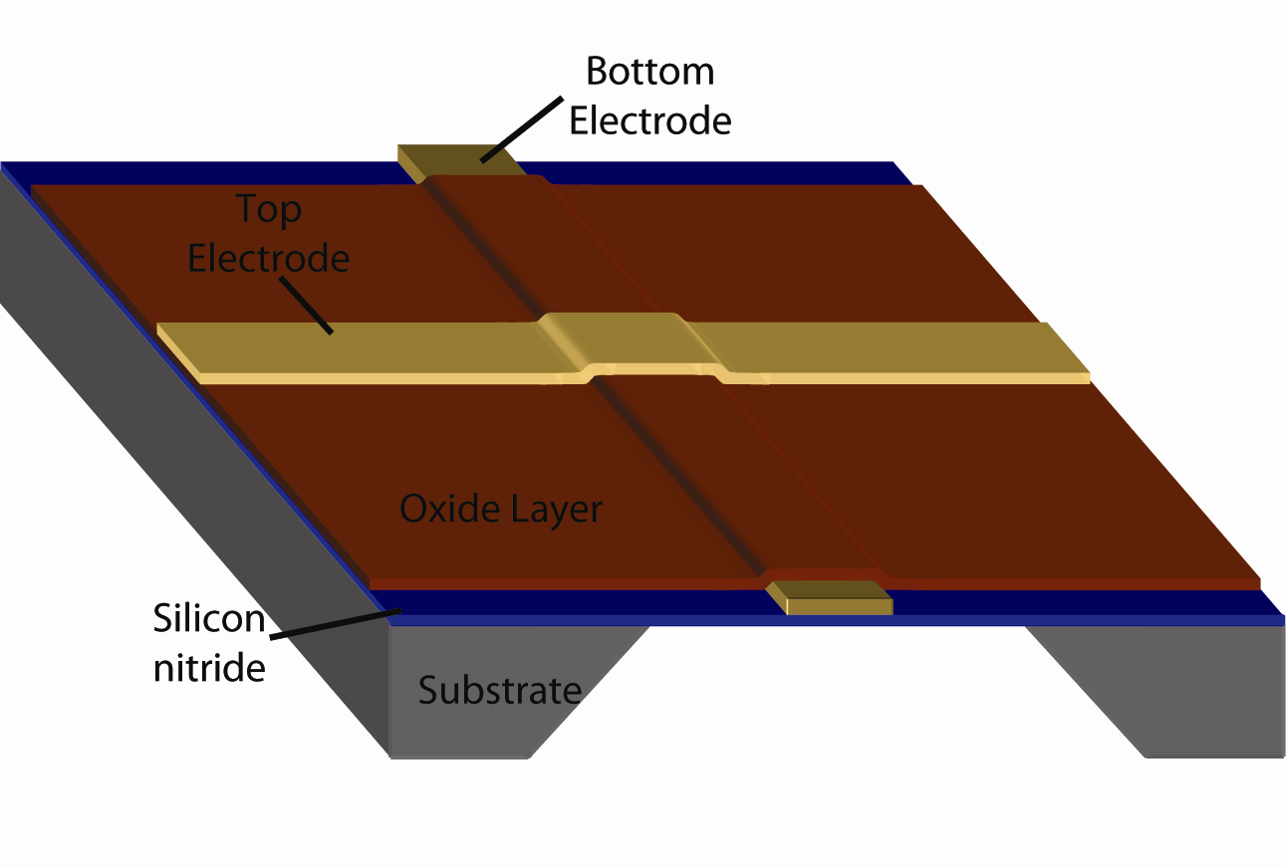
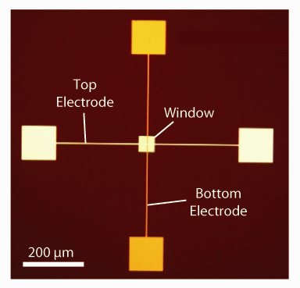
X-ray spectromicroscopy and TEM of TiO₂ NV memristor
Devices fabricated atop thin Si₃N₄ windows
Photograph of actual device
2009
Window
Allows:
1. Non-destructive characterization (no delamination or cross-sectioning)
2. X-ray or Electron microscopy of same device
3. In-situ electrical addressing of device during characterization

Slide 26
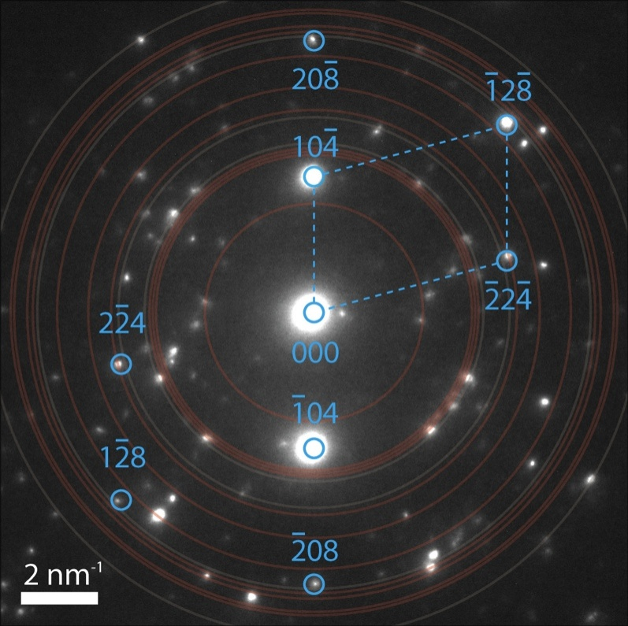
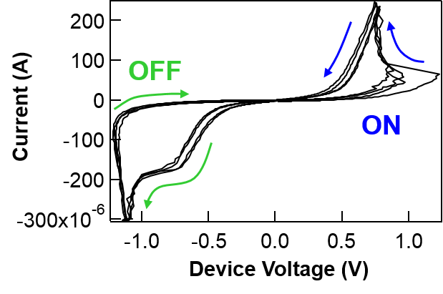
Chemical/Structural Mapping by XAS
TEM - Electron diffraction
TiO₂ Amorphous
8
Diffraction pattern identifies the reduced phase as crystal Ti₄O₇
TiO₂ Anatase
TiO_{2-x} Reduced
6
Absorption (a.u.)
Ti₄O₇ is:
Stable sub-oxide of TiO₂
Member of Ti_{n}O_{2n-1} Magneli phases
Metal-Insulator Transition 140-150K
4
J.P. Strachan, M.D. Pickett, J.J. Yang, S. Aloni, A.L.D. Kilcoyne, G. Medeiros-Ribeiro, R.S. Williams, Advanced Materials 22, 3573 (2010)
2
0
455
460
465
470
X-ray energy (eV)

Slide 27
Ramifications of the X-ray characterization
Deliberately engineer devices with Ti₄O₇ layer from the beginning to eliminate “electroforming”
Broad range of stable phases Ti_{n}O_{2n-1} for n>2, suggests many “intermediate states” can form, limits cycling endurance
Pt / 35nm “Ti₄O₇” / 5nm TiO₂ / Pt
Simpler phase diagram of TaO_{x} system 10⁶ → 10¹² endurance
TiO₂
Pt
TaO_{x}
Ti₄O₇
Pt
TiO₂
Yielded lower voltage operation and lower variability

Slide 28
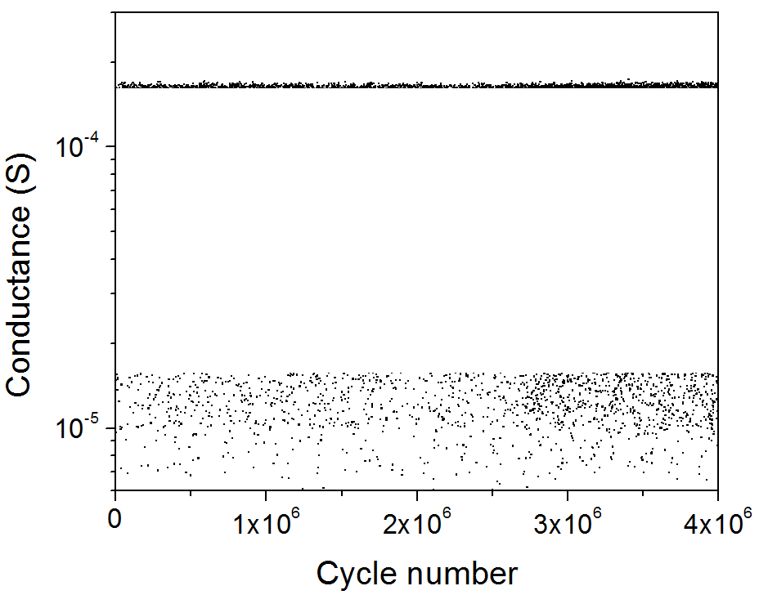
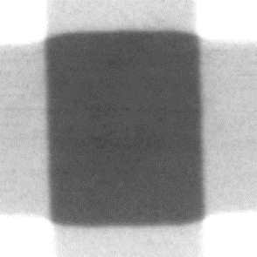
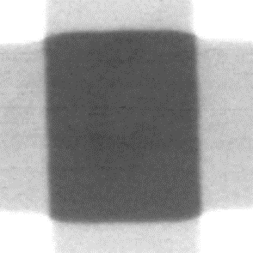

2015
ON
in operando analysis of TaOx
Applied roughly +1.25 V, -2.0 V
Only imaging device states with
G_{ON} > 1.5e-4 S (~ 6 kΩ)
G_{OFF} < 1.5e-5 S (~66 kΩ)
Gating
pulses
OFF
ON
✓
✗
✓
✗
✓
Device
pulses
0
t
OFF
X-ray
pulses
2 μm
Despite large conductance change, material changes are extremely small and no localization observed for small power operation
+0.05
ΔOD
X-ray intensity
0
I_{OFF}
I_{ON}
ln (I_{OFF}/I_{ON})
-0.05
Within crosspoint area, Abs_{OFF} - Abs_{ON} = +0.0015 ± 0.0002 (SNR ≈ 7)
Outside of crosspoint area, No signal above noise level

Slide 29
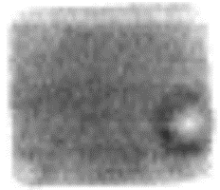
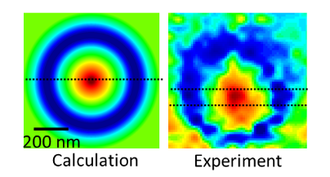
Spectroscopy of device regions: field and temperature effects
2 μm
X-ray intensity
“dark” region
“bright” region
Additional experiment: Apply +V vs 0V and look for Joule heating
localized current flow in bright region only!

Slide 30
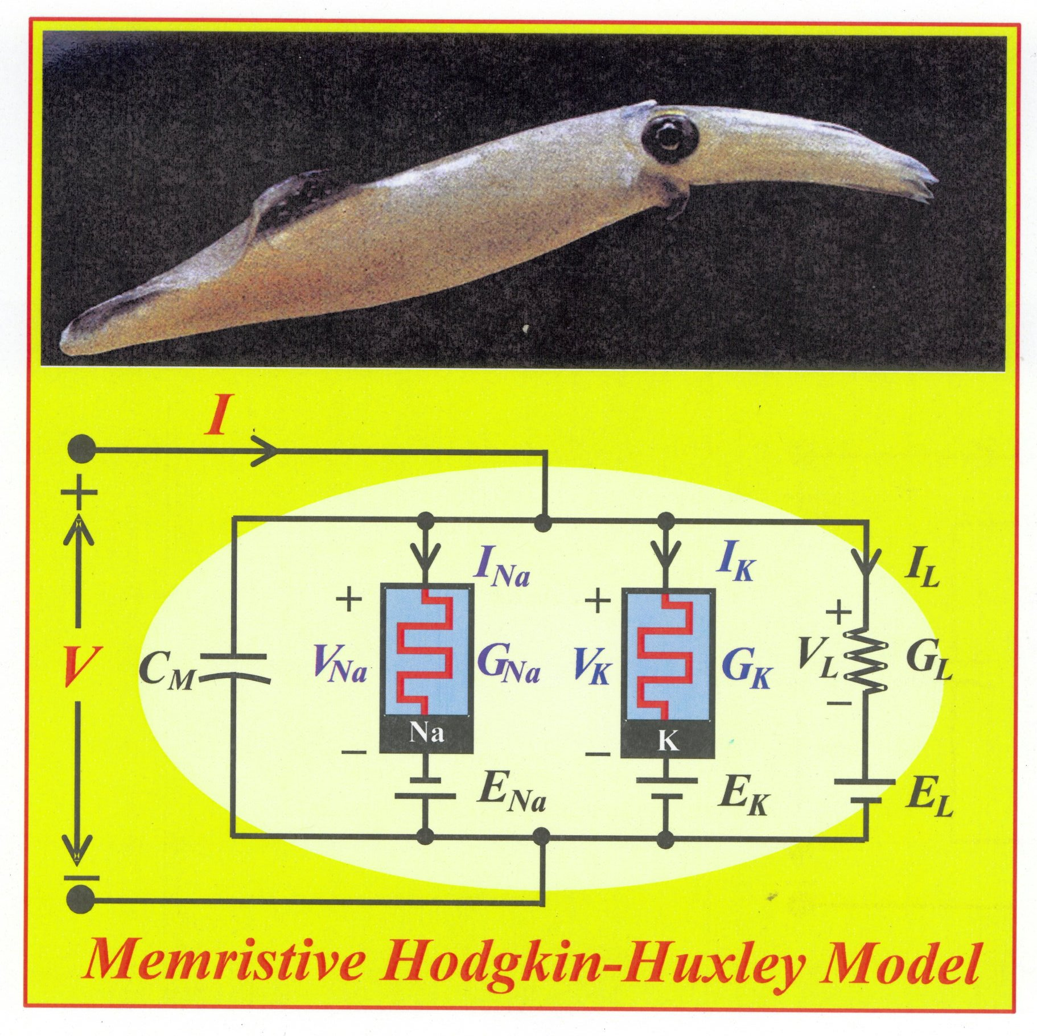
Leon Chua’s Version of the Hodgkin-Huxley Model
Biased at the
‘Edge of Chaos’!
Brains are finely tuned to
operate right at the line
that separates chaos from
epilepsy.
Is this the key to creativity
and intuition?
L. Chua et al., “Hodgkin-Huxley Axon is made of Memristors,”
International Journal of Bifurcation and Chaos 22 (2012) art. # 1230011.

Slide 31
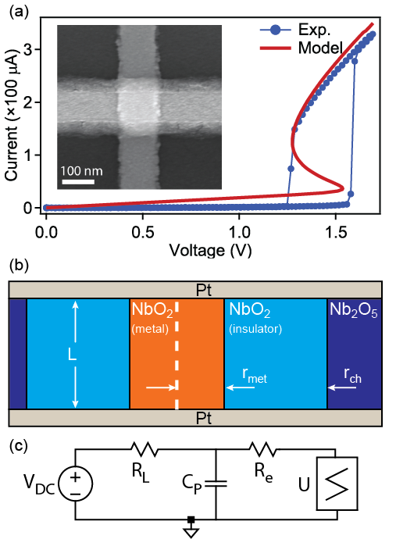
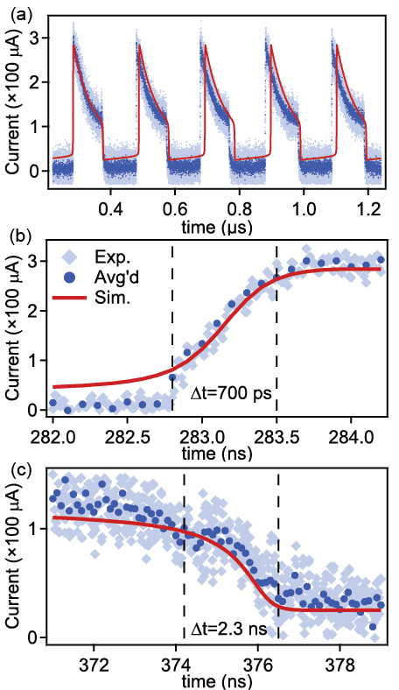
NbO₂ Locally Active “Mott” Memristor – thermoelectric switching
Oscillator with DC bias!
r_{ch} =
30 nm

Slide 32
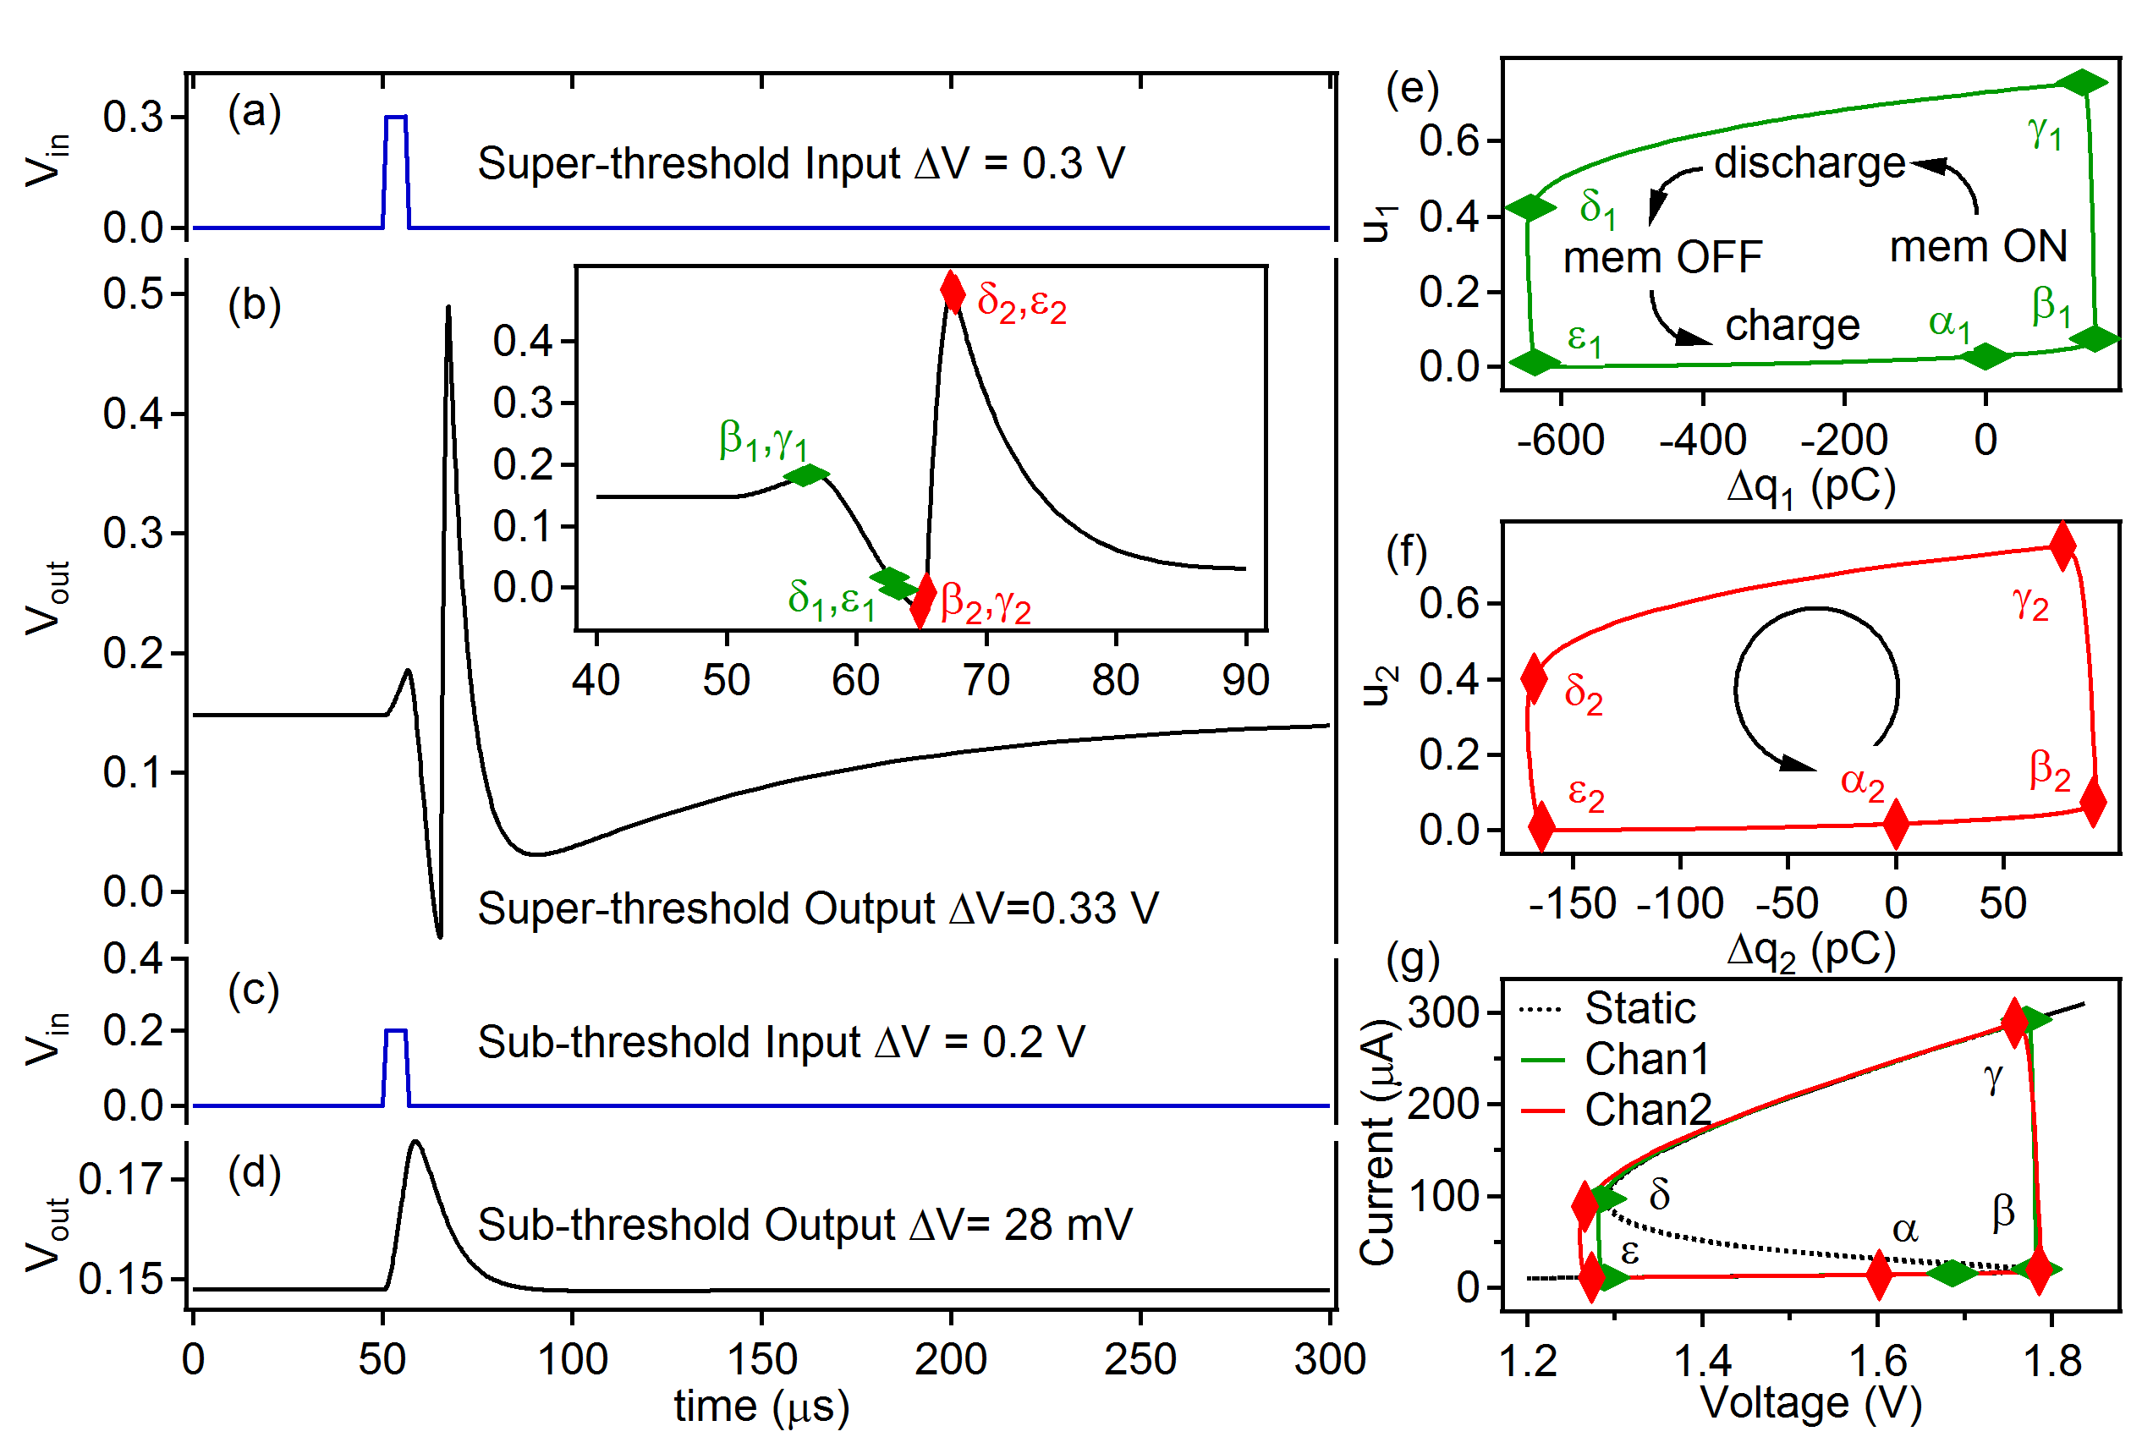
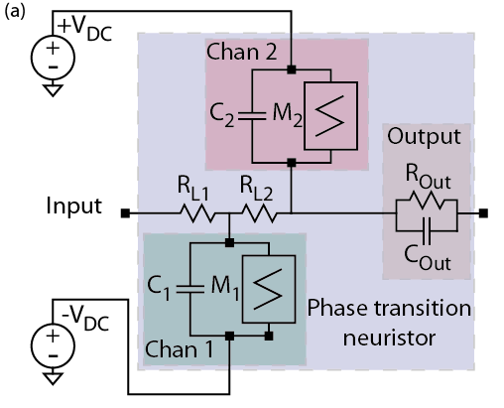
A Neuristor inspired by the Hodgkin-Huxley model
Implements “All or Nothing” spiking:
500 times faster than a neuron
2% of the energy of a squid neuron
M. D. Pickett, et al, Nature Materials 12, 114 (2013).

Slide 33
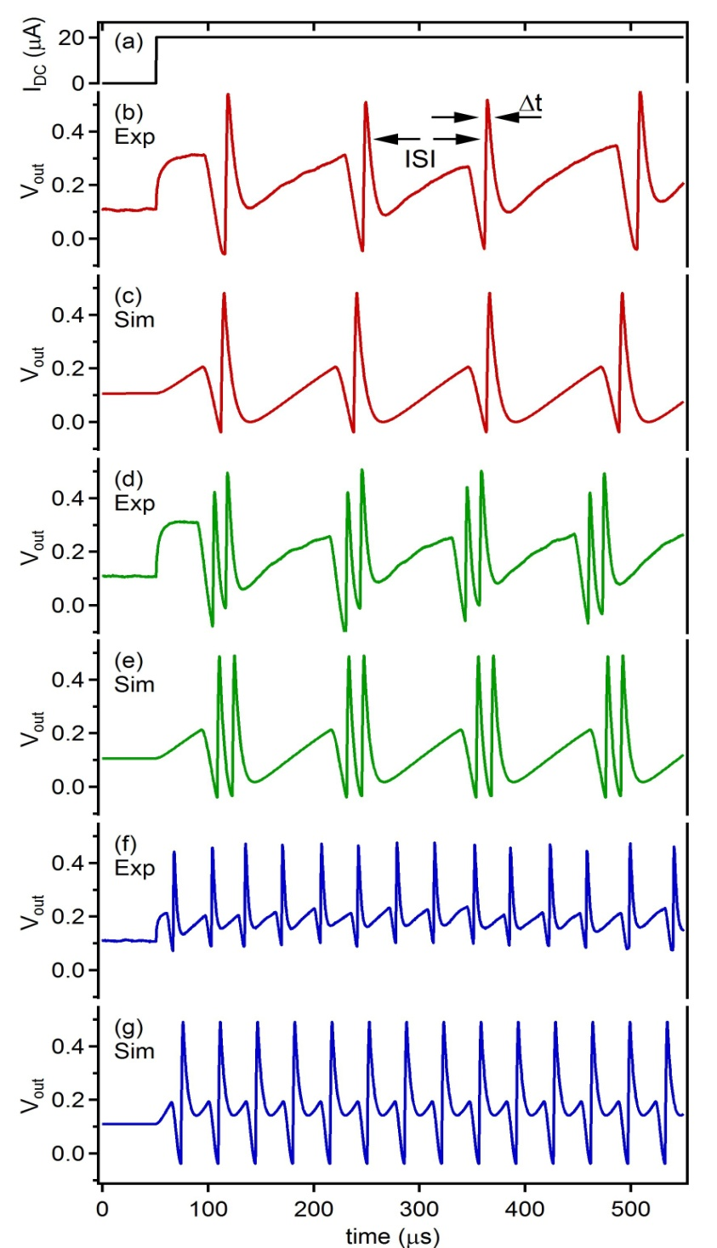
Neuristor spiking emulates action potential seen in brains
“Regular Spiking”
C₁=5.1 nF, C₂=0.75 nF
“Chattering”
C₁ = 5.1 nF, C₂ = 0.5 nF
“Fast Spiking”
C₁=1.6 nF, C₂=0.5 nF

Slide 34
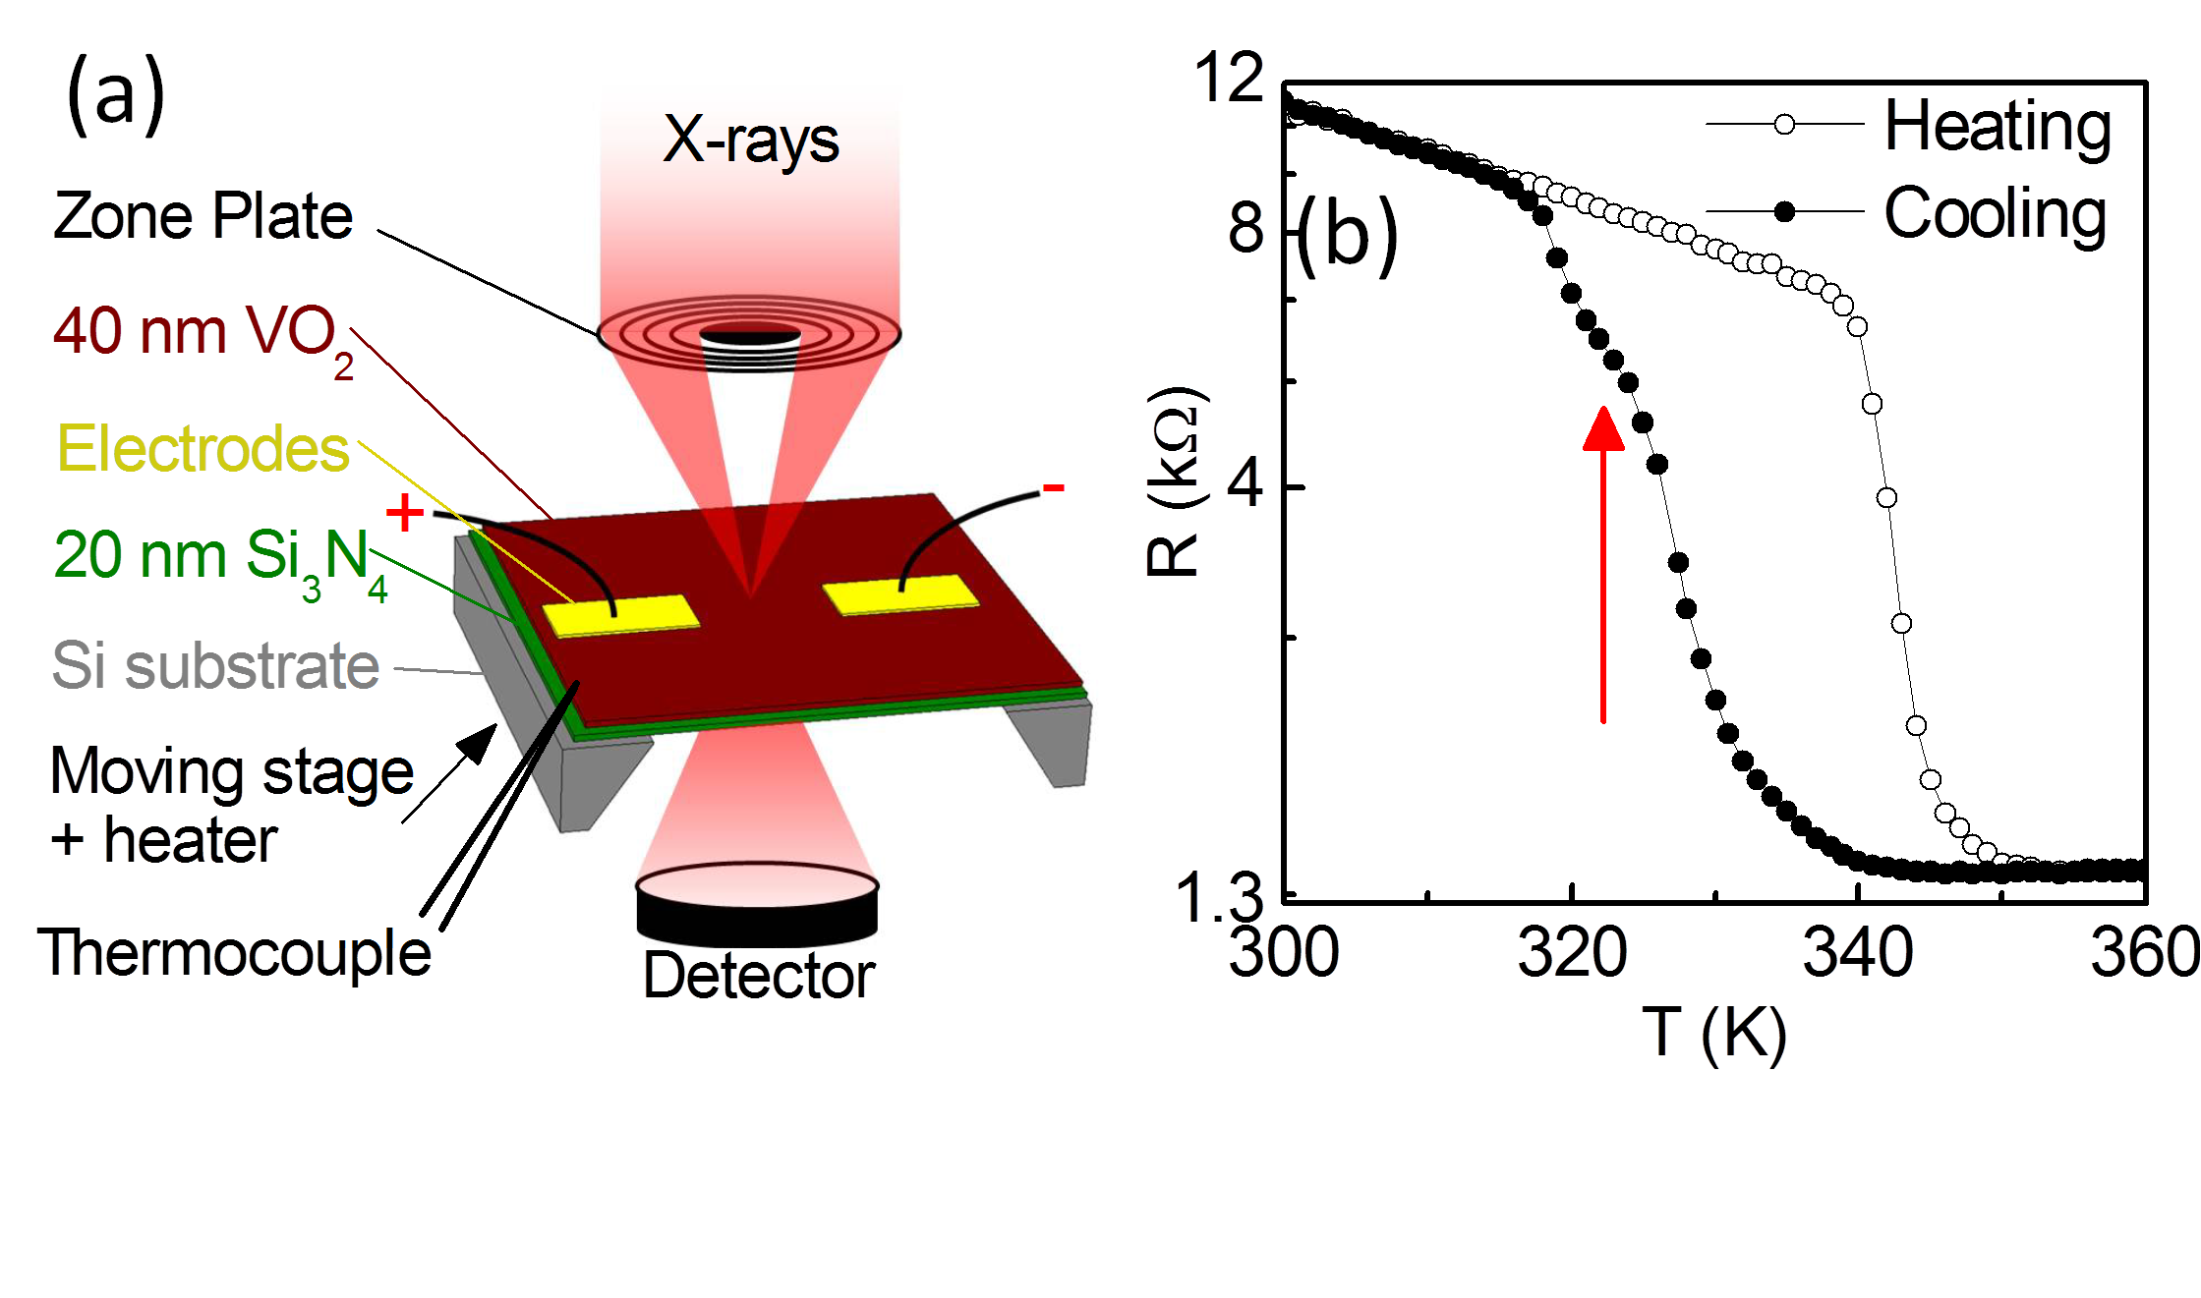
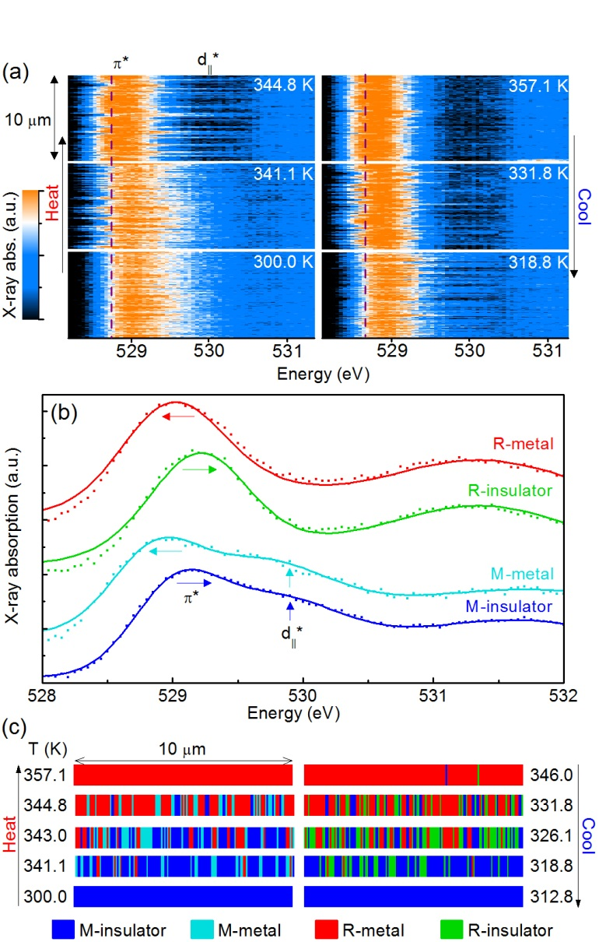
Drove our research into phase transition materials/devices
In VO₂, local heating drives Mott-Peierls transition = locally active memristor
Measure T also!
Identified two unknown metastable phases!
X-ray structural and electronic mapping shows the Mott and Peierls transitions are not simultaneous
S. Kumar, et al., Advanced Materials, (2014)

Slide 35
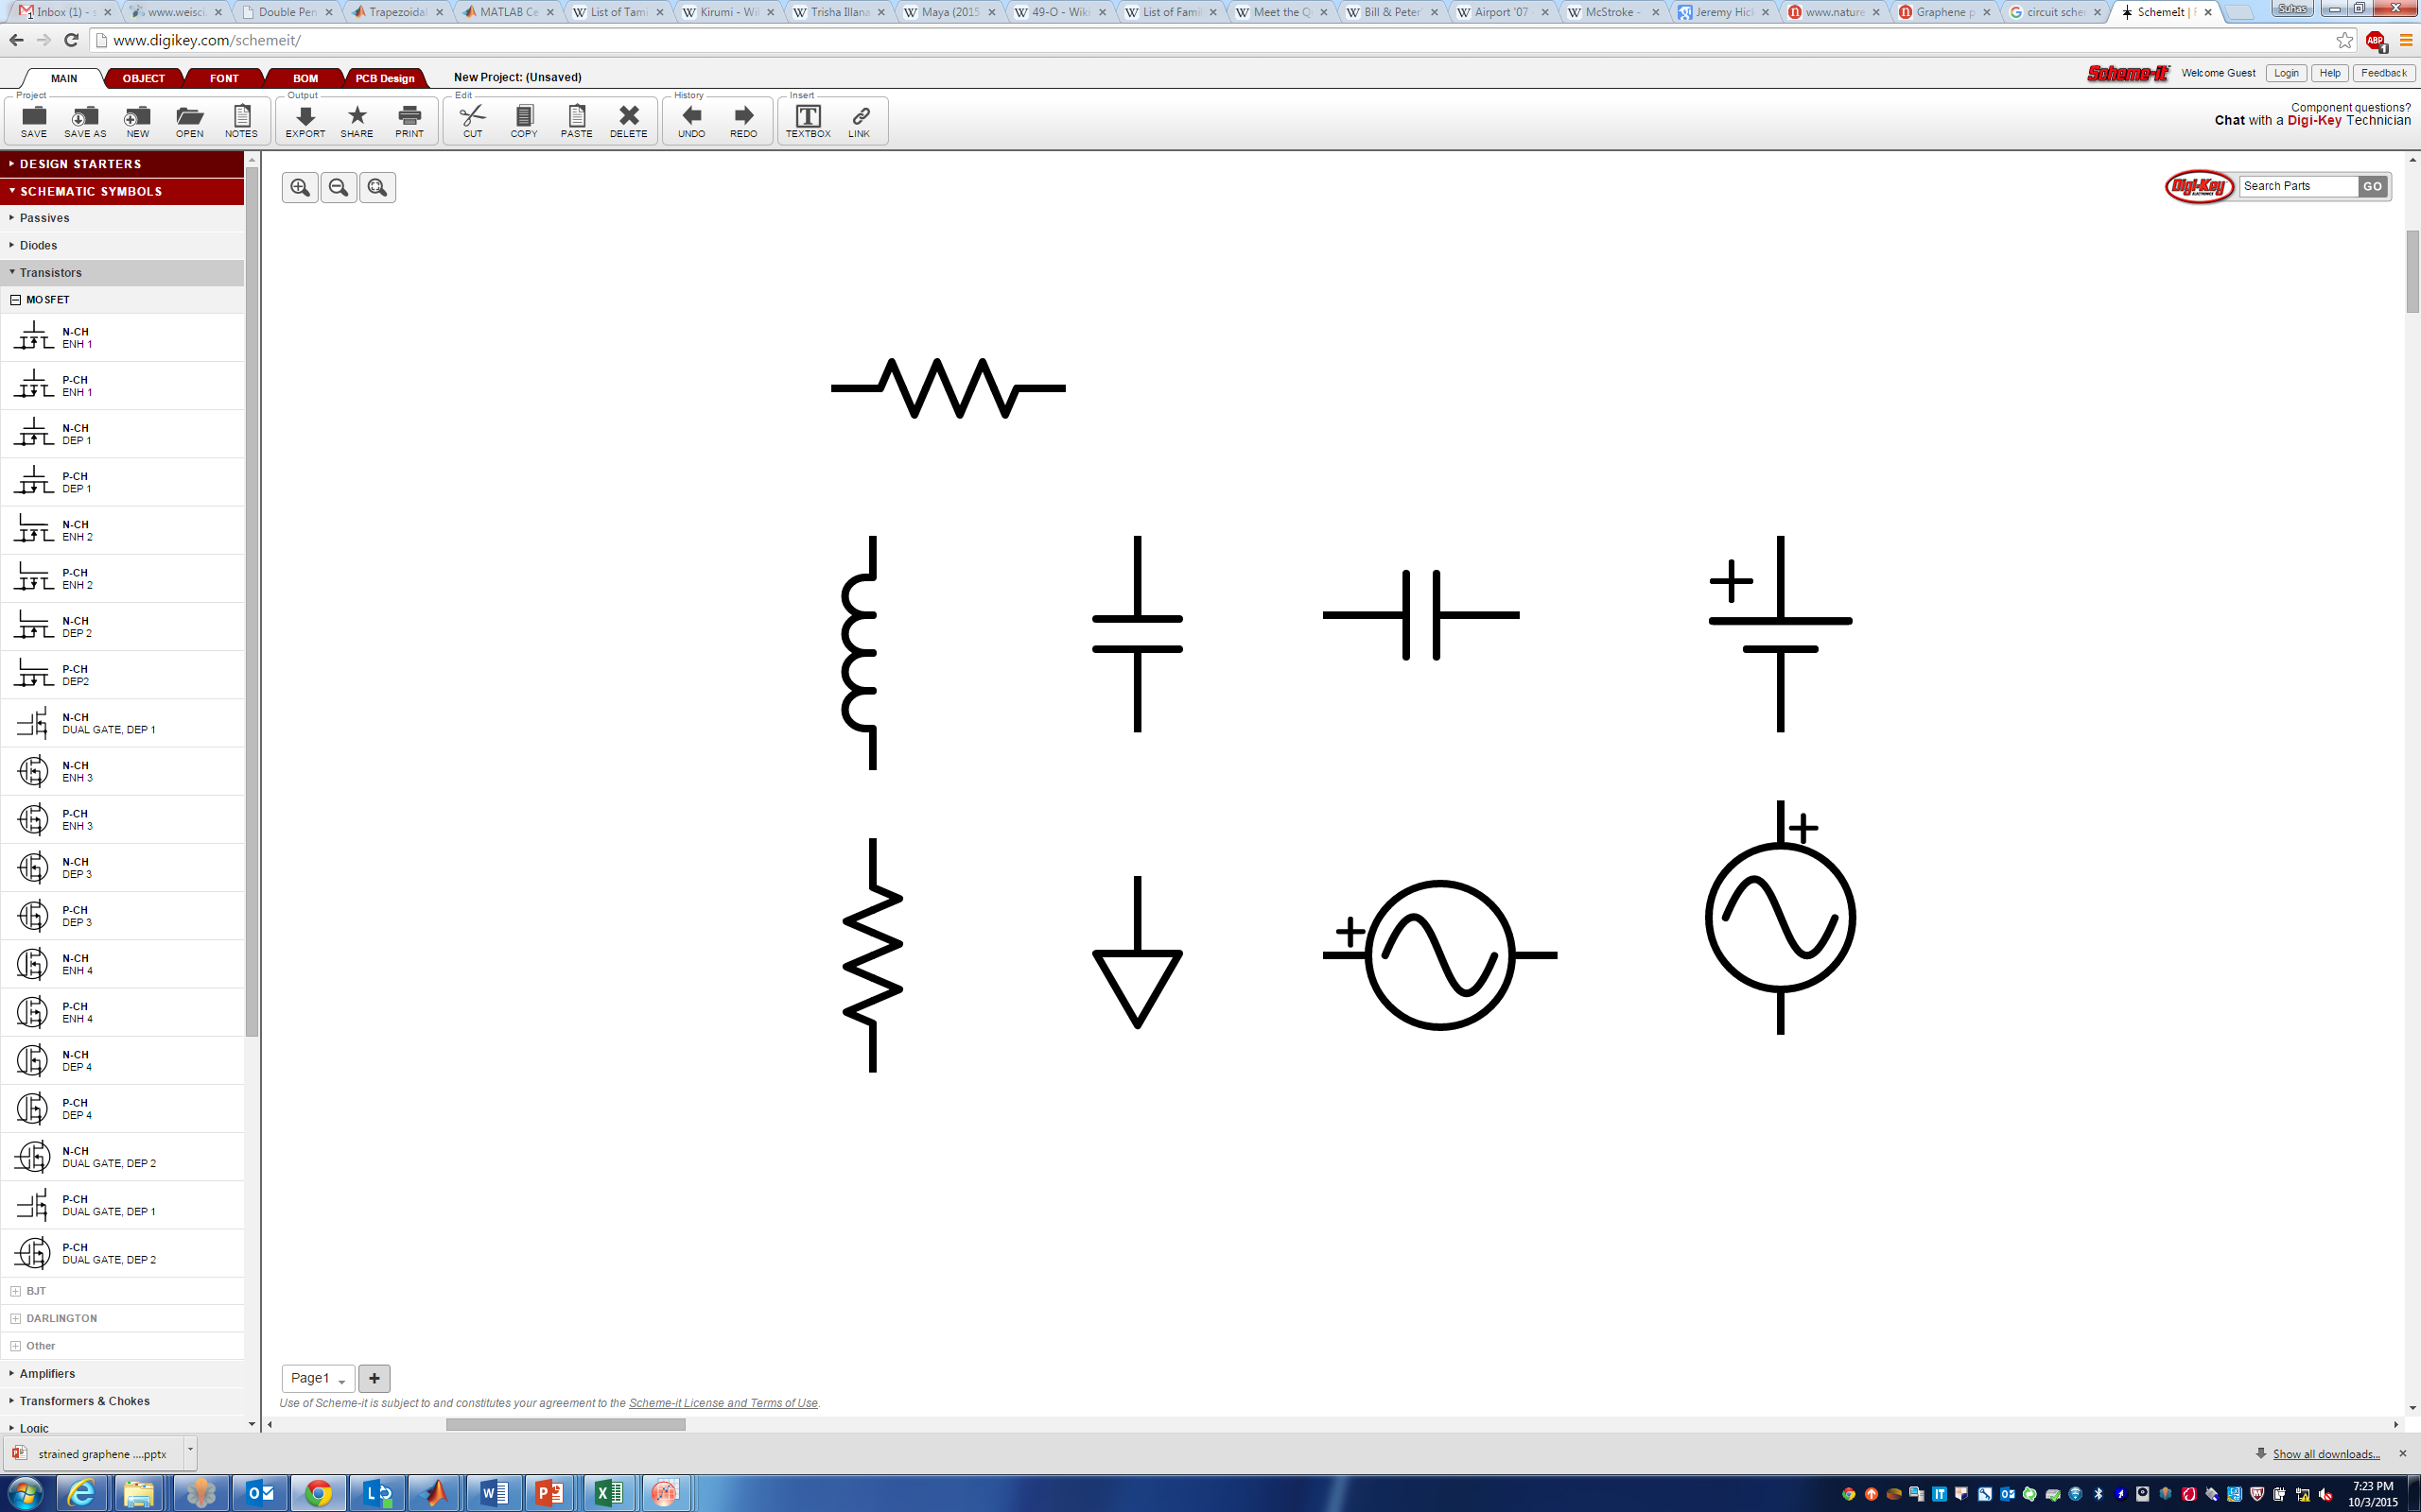
Integrated Neuristors – thermoelectric design
Pt top electrode
TiN
NbO_{x}
T_{N}
R_{th}C_{th} ≤ 0.1 ns
R_{th} ≥ 10⁶ K/W
C_{th} ≤ 10⁻¹⁶ J/K
10x faster
0.1x energy
of previous device
R_{th}
≤ 0.1 nF
SiO₂
C_{e}
TiN
Nanovia
C_{th}
SiN_{x}
T_{amb}
W bottom electrode
Dark field cross-sectional TEM image of NbO_{x} memristor. The heated region is thermally connected to T_{amb} through the effective thermal resistance, R_{th}, and thermal capacitance, C_{th}.

Slide 36
Acknowledgments
Erik P. DeBenedictis, Sandia National Laboratories
Thomas M. Conte, Georgia Tech
David J. Mountain, LPS
IEEE Rebooting Computing
My Research Group and HPE Labs Colleagues

